Slide 1

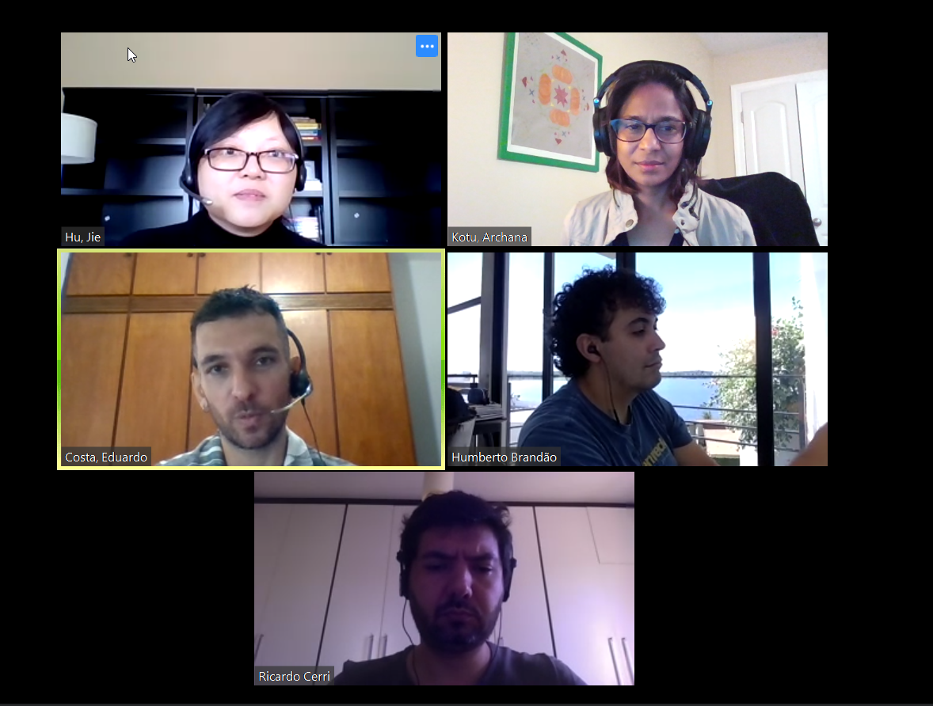
Stock Me Up (Not Toilet Paper)!
Team Zoombies
Jie Hu (Indianapolis)
Archana Kotu (Johnston)
Eduardo Costa (Brazil)
Humberto Brandão (Federal University of Alfenas)
DSI Hackathon
April 28-30, 2020
Ricardo Cerri (Federal University of São Carlos)

Slide 2
Stock Me Up (Not Toilet Paper)!
Objectives:
Historical performance analysis of stock prices of Agribusiness companies
Comparison with S&P 500 index and other sectors
Insights into investment opportunities
Data:
List of S&P 500 companies collected from Wikipedia web page
Company daily stock prices from 2010-01-01 to 2020-04-28 retrieved using Yahoo Finance’s API and Quandl API
S&P 500 stock market index daily prices from 2010-01-01 to 2020-04-28 collected from Wall Street Journal web page
Sentiment analysis data from 2010 to 2019 crowd-sourced by RavenPack
Questions:
How did Agribusiness company stocks perform over the past 10 years? Compared to stocks in other business sectors?
Which stocks may worth investing during this COVID-19 pandemic?
Is sentiment predictive of company stock returns?

Slide 3
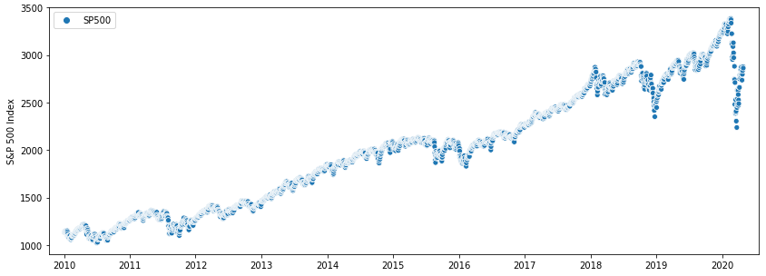
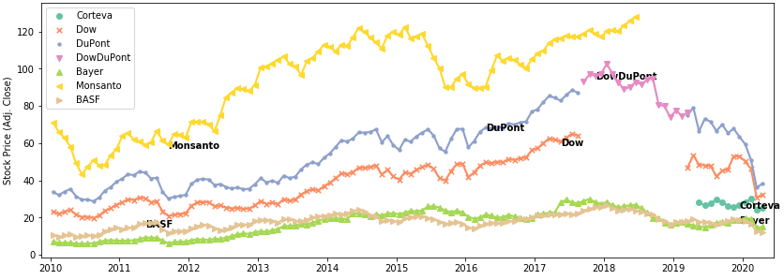
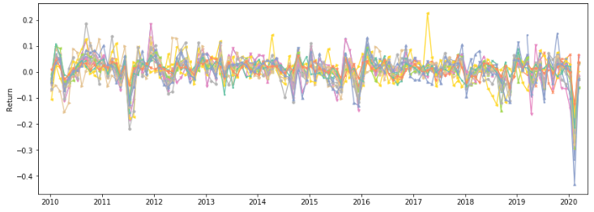
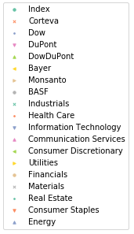
10-year Performance of Agribusiness Companies
10-year growth of S&P 500 stock market index
Stock growth of agribusiness companies
COVID-19 outbreak
Stock returns of agribusiness vs. other business sectors
Bayer

Slide 4
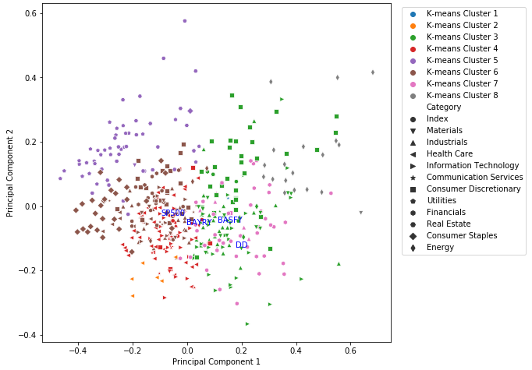
Stocks in Same Business Sectors Perform Consistently

Slide 5
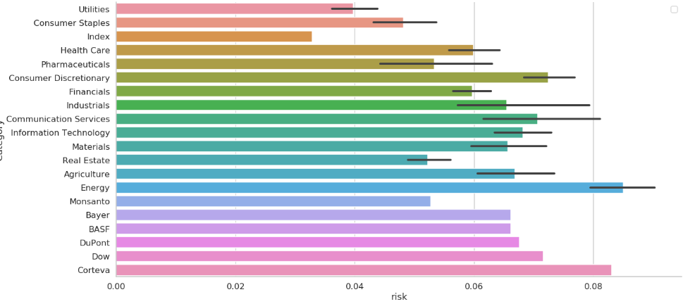
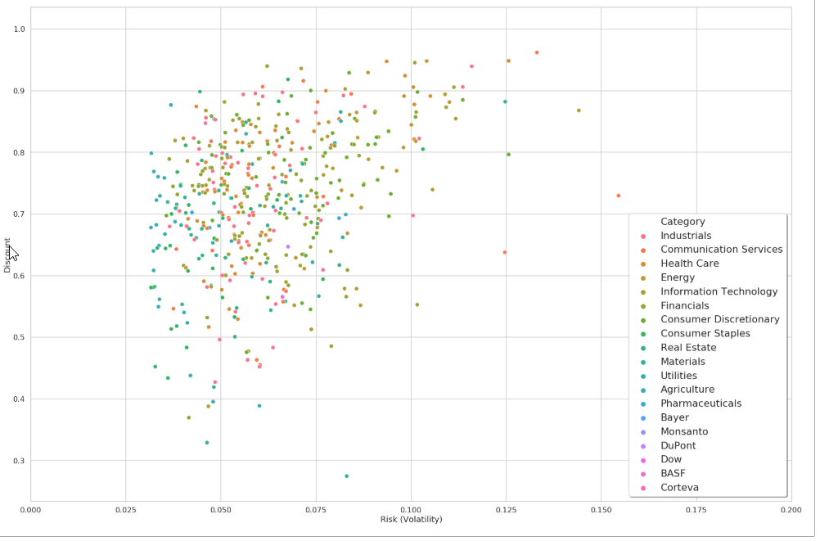
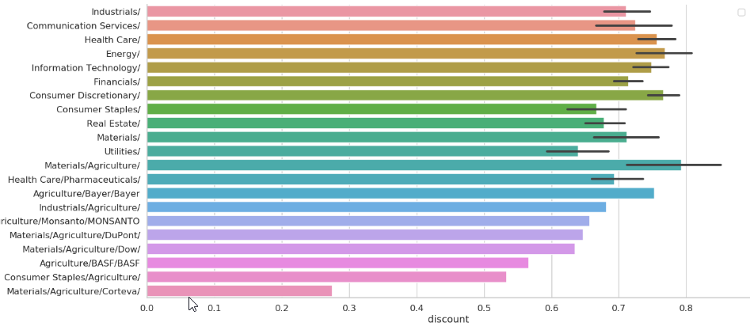
Stocks Worth Investing During COVID-19 Pandemic
Risk (Volatility)
Discount Vs Risk
Monsanto
Discount
Dow
Mean Discount
Corteva
Risk

Slide 6
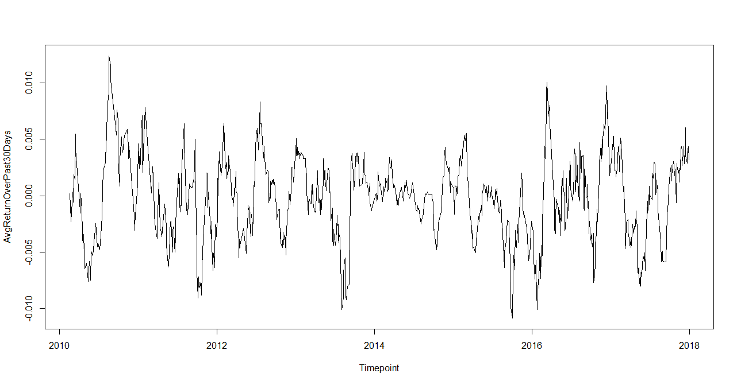







Can Machine Learning Predict Stock Returns?
Historical Prices
Sentiment Analysis from the news
Sentiment Feature Extraction
Time Series Feature Extraction
Lag Features
Individual Past returns
Past 7 days
Rolling window features
7-day moving average
30-day moving average
Historical volatility
Machine Learning
Ridge Regression
Neural Networks
XGBoost
Predict
Daily return
Absolute daily return
Average weekly return
Proprietary database with features generated from news
News relevance
Novelty index
Sentiment index
News impact
Features extracted from news from past 7 days (for every daily return)

Slide 7
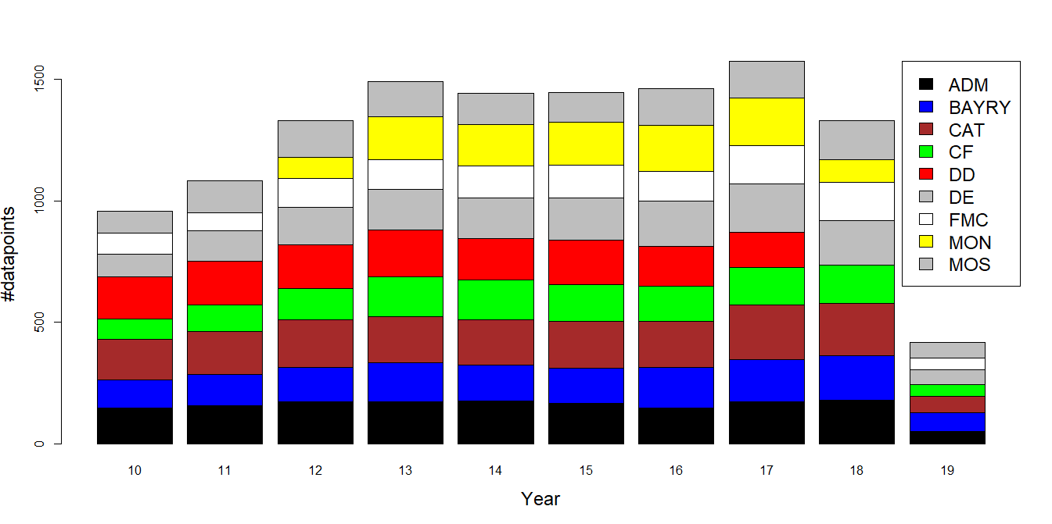
Predicting the Absolute Return of Tomorrow
Predict whether absolute return will be high (>1%) or low (<1%)
Motivation
Assess future risk of a stock
Opportunity for investments
TRAINING: 2010-2017
TEST: 2018-2019
Feature Importance in the model (TOP 10)
ABSmovAverage30d
ABSmovAverage7d
movAverage30d
movAverage7d
Lag2Return
Lag4Return
Lag7Return
Lag6Return
min_nip_5
Lag5Return
 | Predicted: Abs(Return) < 1% | Predicted: Abs(Return) > 1%
Actual: Abs(Return) < 1% | 1541 | 397
Actual: Abs(Return) > 1% | 741 | 639
Only one of the features from the sentiment dataset in the TOP 10
Correct prediction in 62% of the cases
Feature related to news relevance

Slide 8
Summary
S&P 500 stock market index has enjoyed 10 years of growth until recent COVID-19 outbreak
Agribusiness companies performed similarly with S&P 500 index and other business sectors overall and experienced opportunities and challenges during merger and acquisition in the past few years
Stocks in same business sectors perform consistently
During COVID-19 pandemic, company stocks that are highly discounted and have low volatility (risk) are worth investing
Agribusiness companies have moderate risk historically and some are highly discounted during COVID-19
Sentiment is not very predictive of company stock returns based on a preliminary study over a small dataset
Future directions:
Other machine learning methods and data
Detailed analysis of stocks that worth investing

